Slide 1
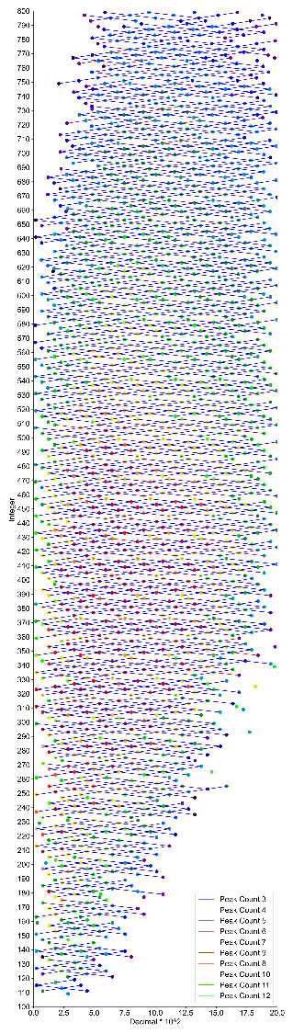
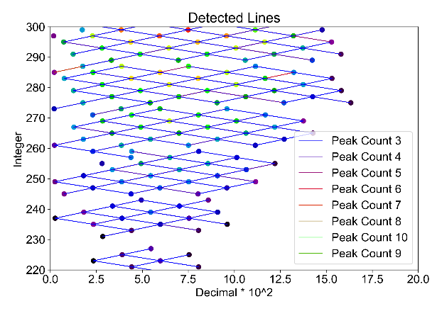
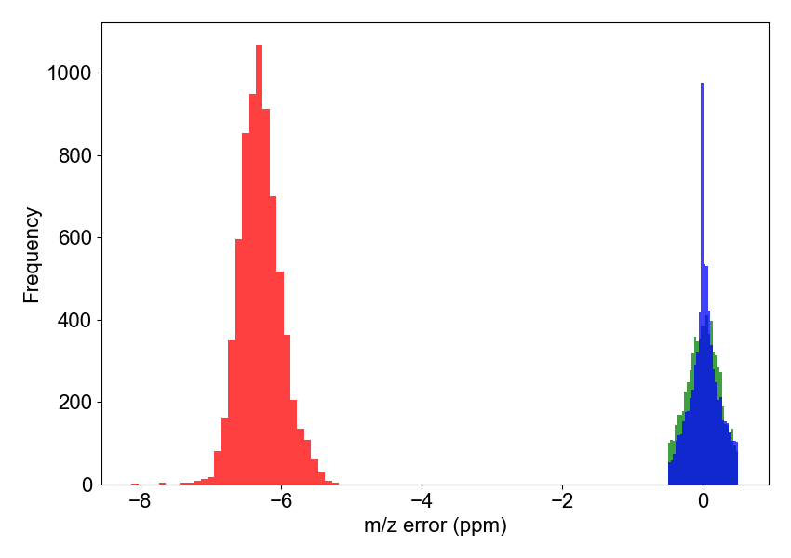
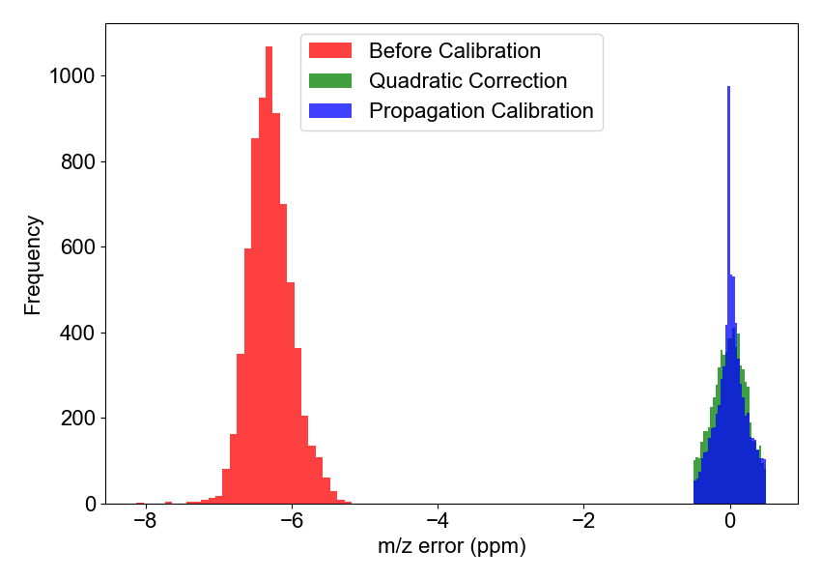


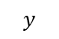
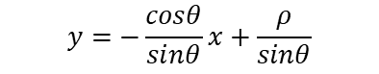
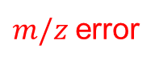



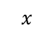


$$m/z = integer + decimal$$
$$x$$
$$y$$
200
300
400
500
600
700
m/z
1
Coordinate Transformation
Calibrating 𝑚/𝑧 by Calibrating Line
2
3
“Homologous” $m/z$Line Detection
$m/z$error
$$y=−\frac{cosθ}{sinθ}x+\frac{ρ}{sinθ}$$
Results Comparison
4
Decimal ($m/z$)
$$C=(x_{3},y_{3})$$
$$B=(x_{2},y_{2})$$
Before Calibration
Quadratic Calibration
Propagation Calibration
$$A=(x_{1},y_{1})$$
-8
-6
-4
-2
0
Integer ($m/z$)
m/z error (ppm)

Slide 2
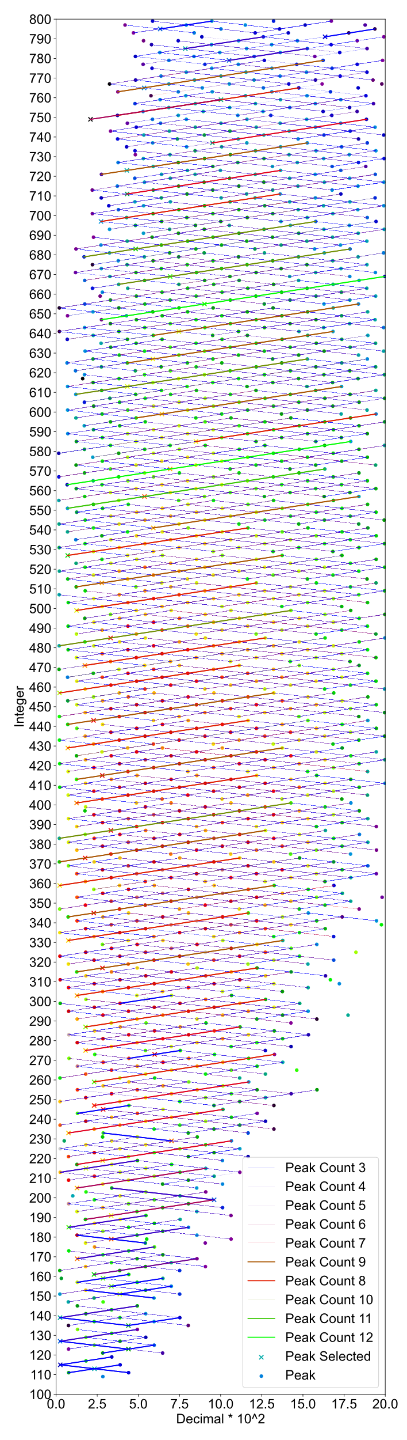
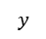
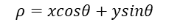
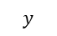
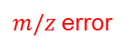
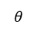
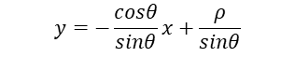
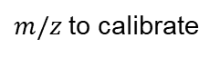
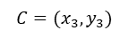

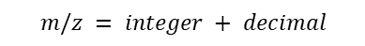

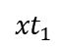
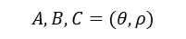
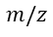
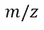
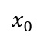
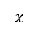
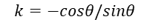

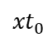
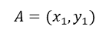

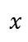
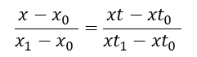
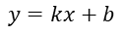
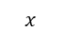
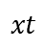
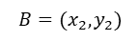
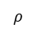

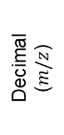
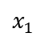
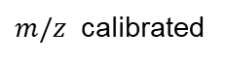
$$y=kx+b$$
$$k=−cosθ/sinθ$$
$$ρ=xcosθ+ysinθ$$
$$m/z = integer + decimal$$
$$b=ρ/sinθ$$
$$y$$
$$ρ$$
$$x$$
$$y$$
$$C=(x_{3},y_{3})$$
$$B=(x_{2},y_{2})$$
$$A=(x_{1},y_{1})$$
$$A,B,C=(θ,ρ)$$
200
300
400
500
600
700
$$m/z$$
$$x$$
1
a
c
$$θ$$
e
Visualization of m/z List on 2D Map
Hough Transform Line Detection
Propagation Calibration
b
Extraction of Peaks for Calibration
d
Calibrating 𝑚/𝑧 by Calibrating Line
f
‘Scaling’ Calibration
$m/z$error
$$x_{0}$$
$$x$$
$$x_{1}$$
$m/z$to calibrate
extract
$$y=−\frac{cosθ}{sinθ}x+\frac{ρ}{sinθ}$$
Decimal ($m/z$)
$$C=(x_{3},y_{3})$$
$$\frac{x−x_{0} }{x_{1}−x_{0} }=\frac{xt−{xt}_{0} }{{xt}_{1}−{xt}_{0} }$$
$$B=(x_{2},y_{2})$$
$$A=(x_{1},y_{1})$$
$$m/z$$
Integer ($m/z$)
$${xt}_{0}$$
$$xt$$
$${xt}_{1}$$
$m/z$ calibrated

Slide 3
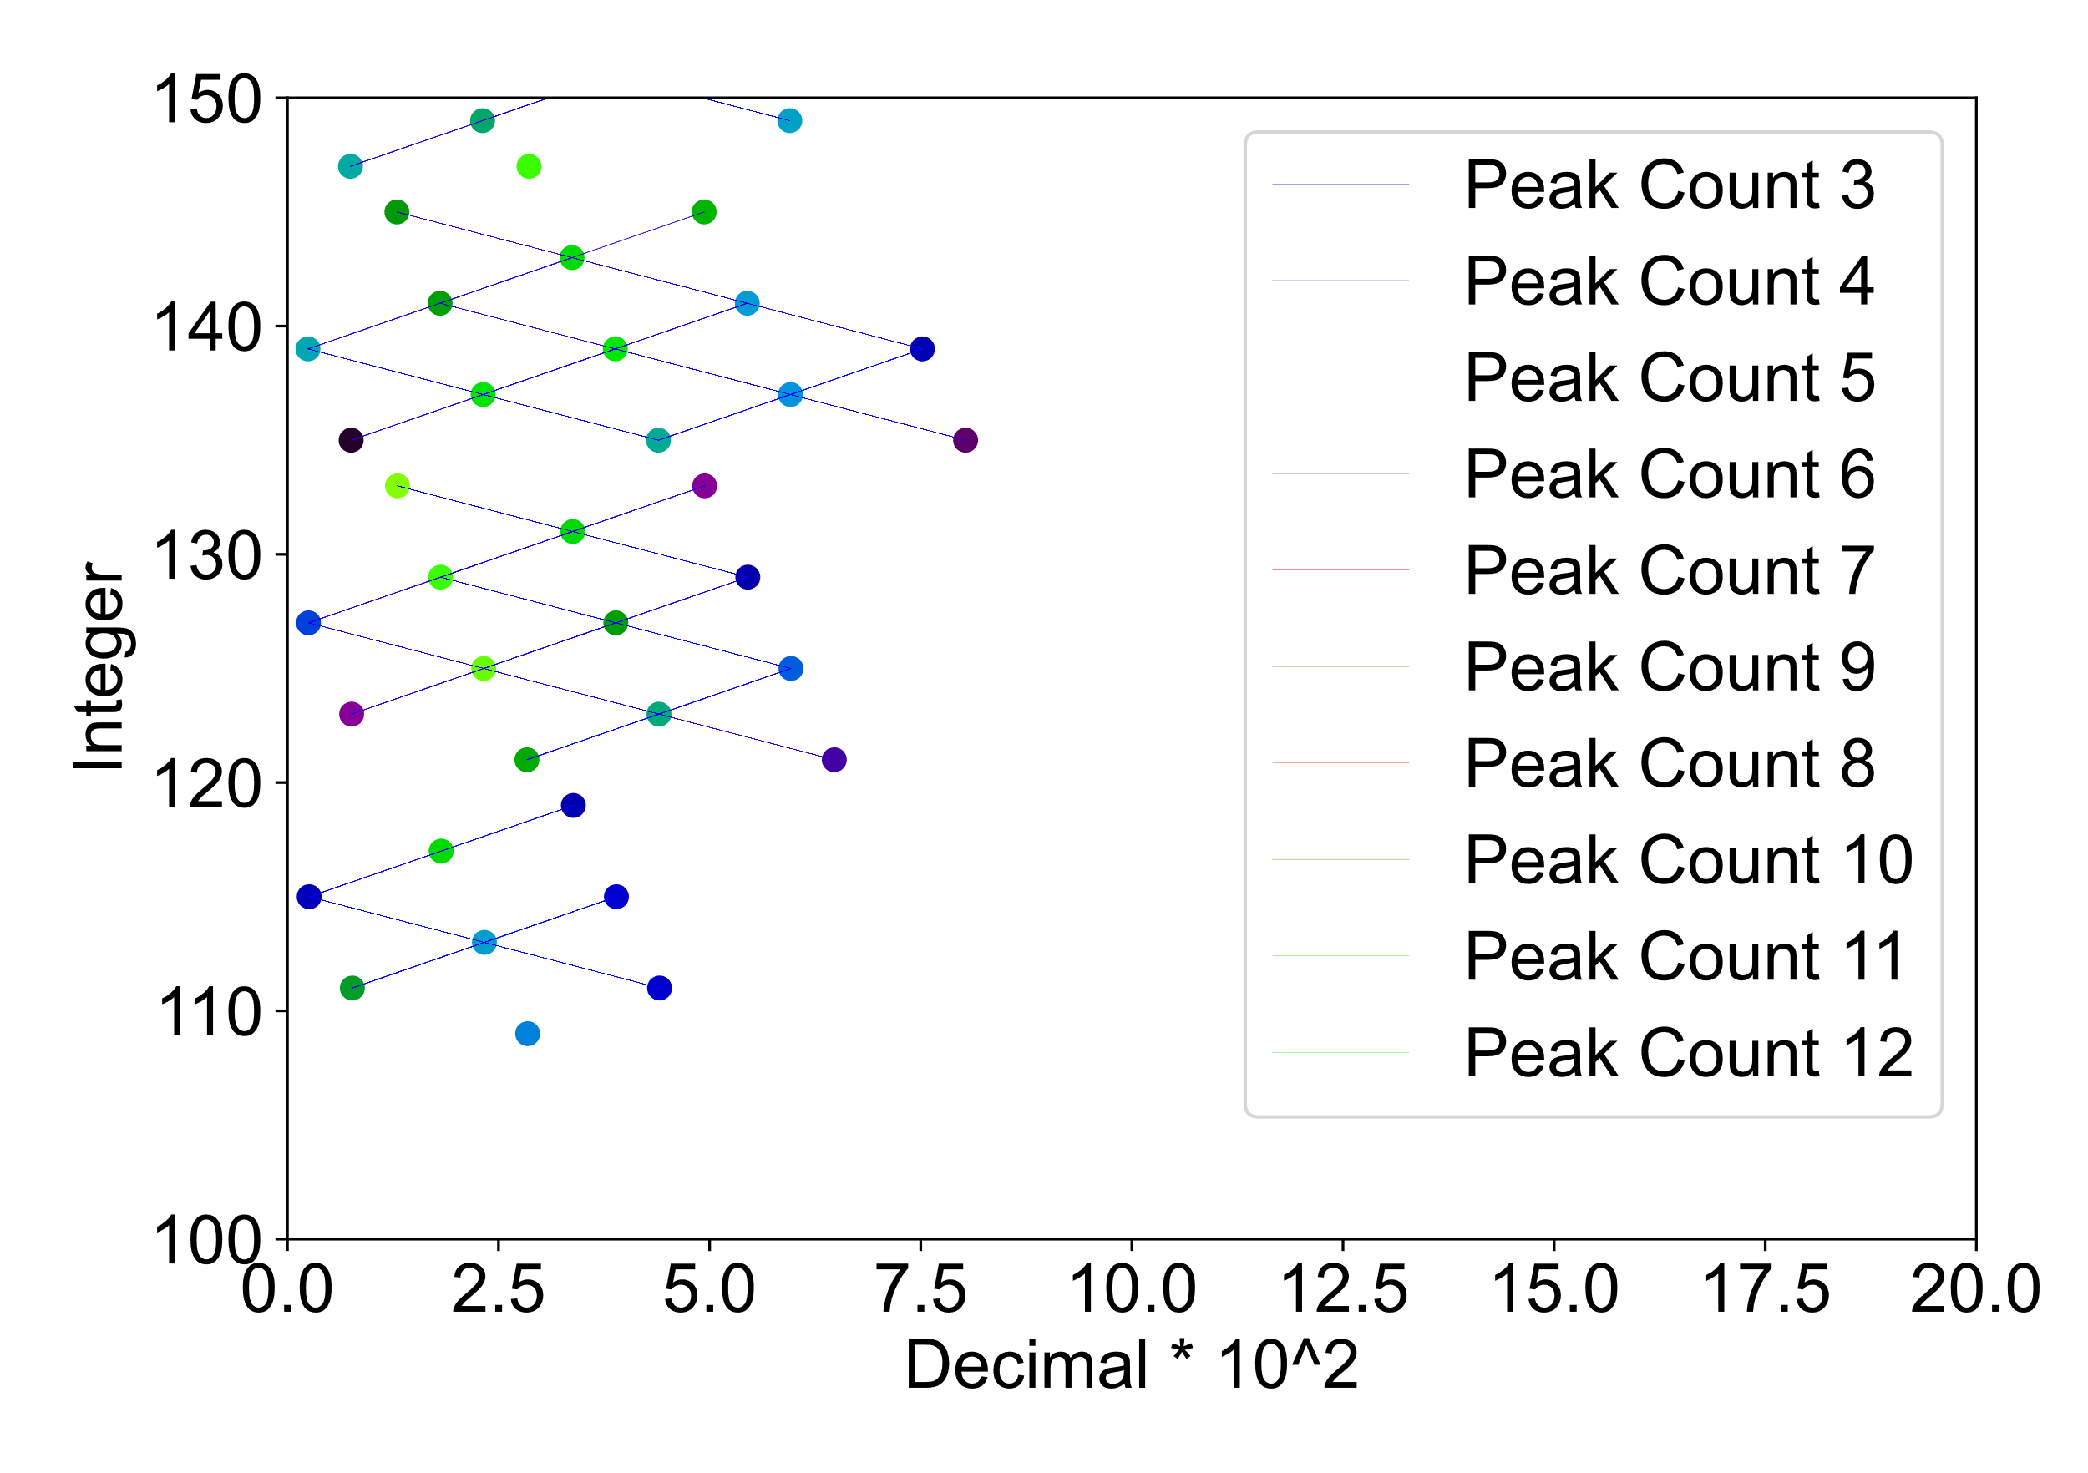
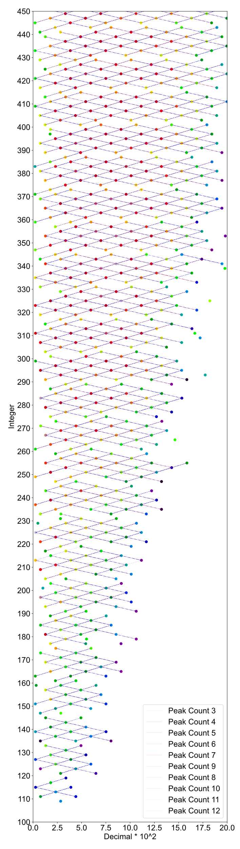
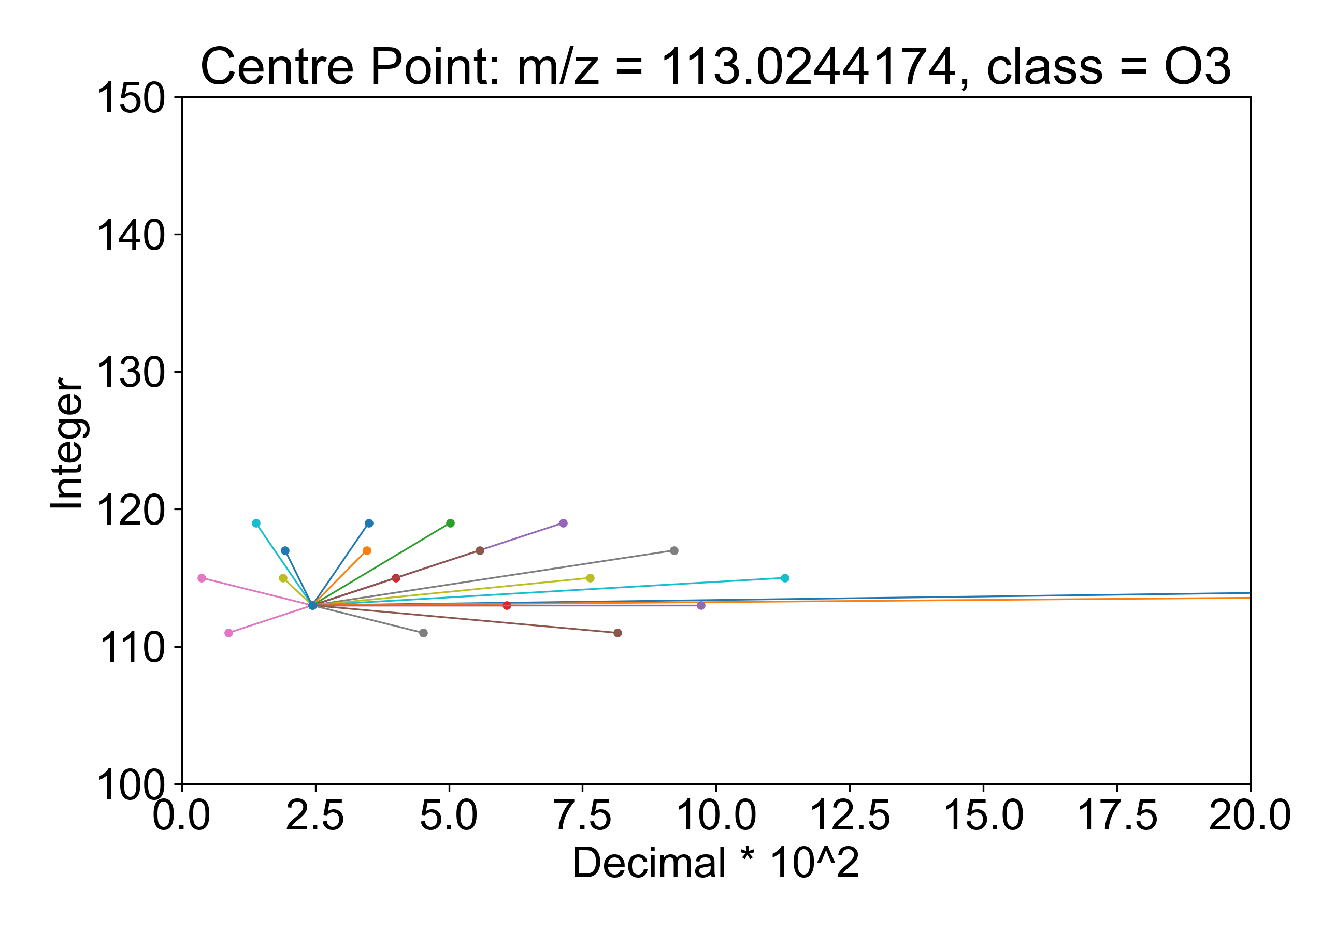
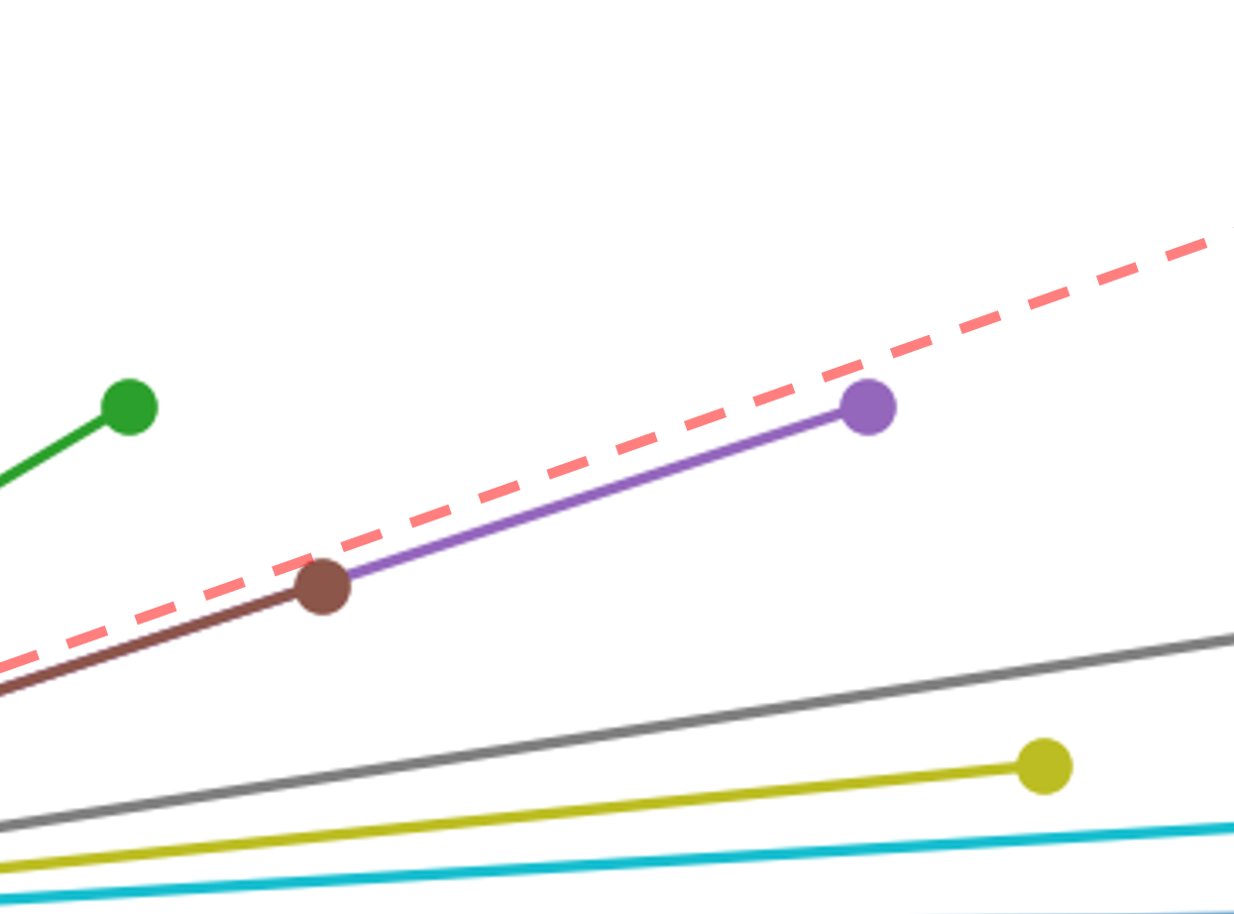
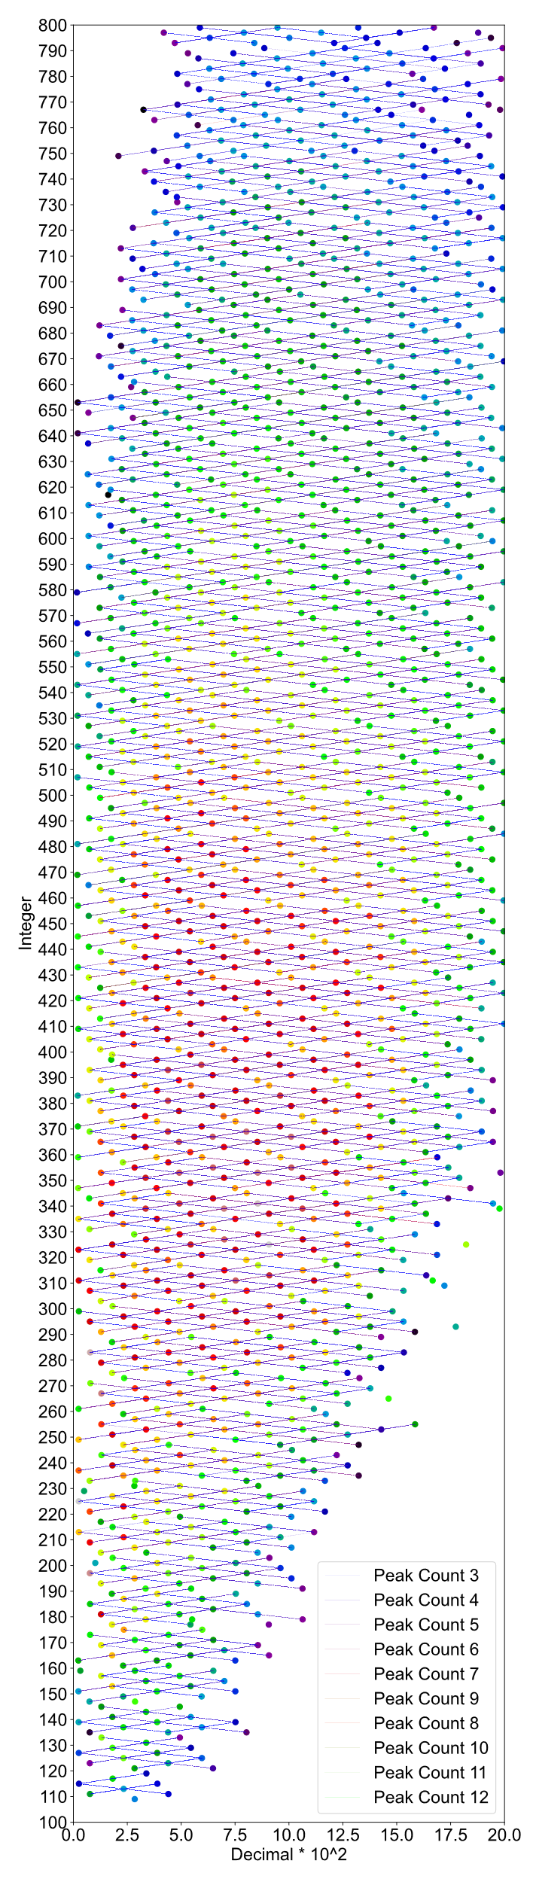
(a)
(b)
(c)

Slide 4
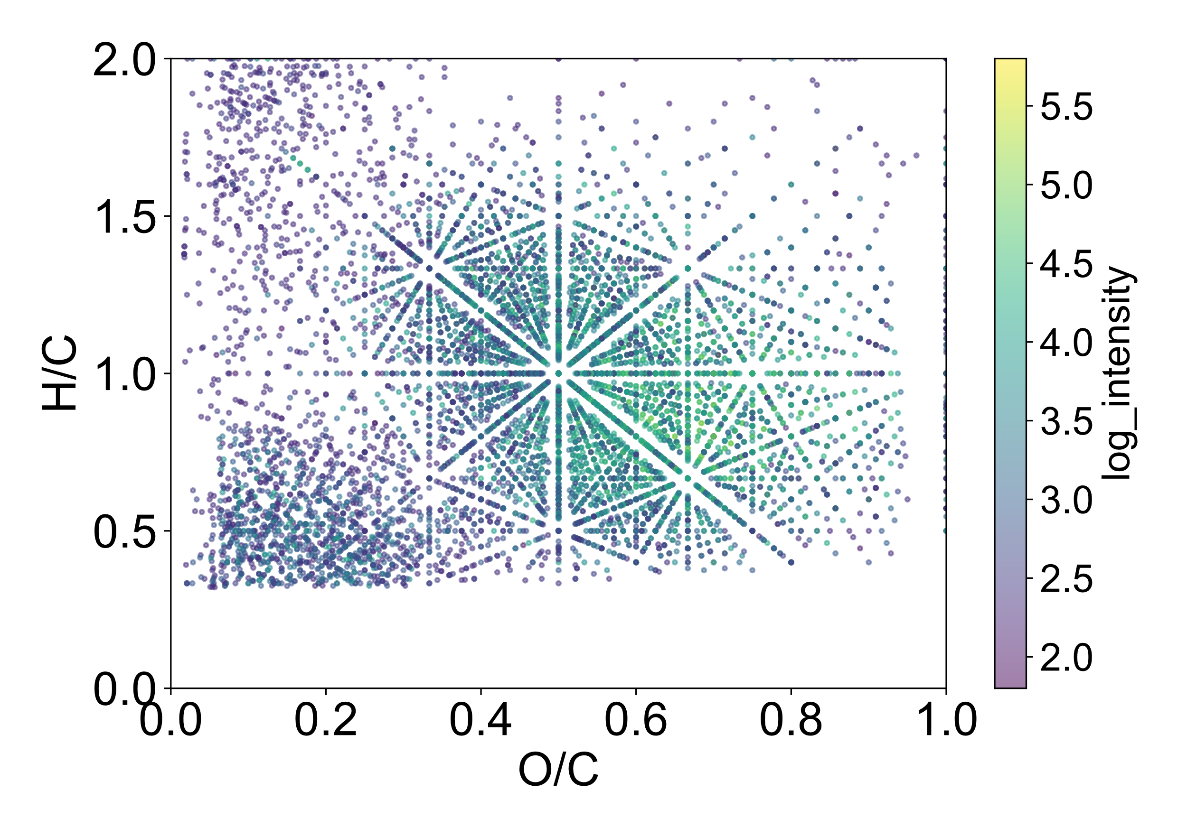
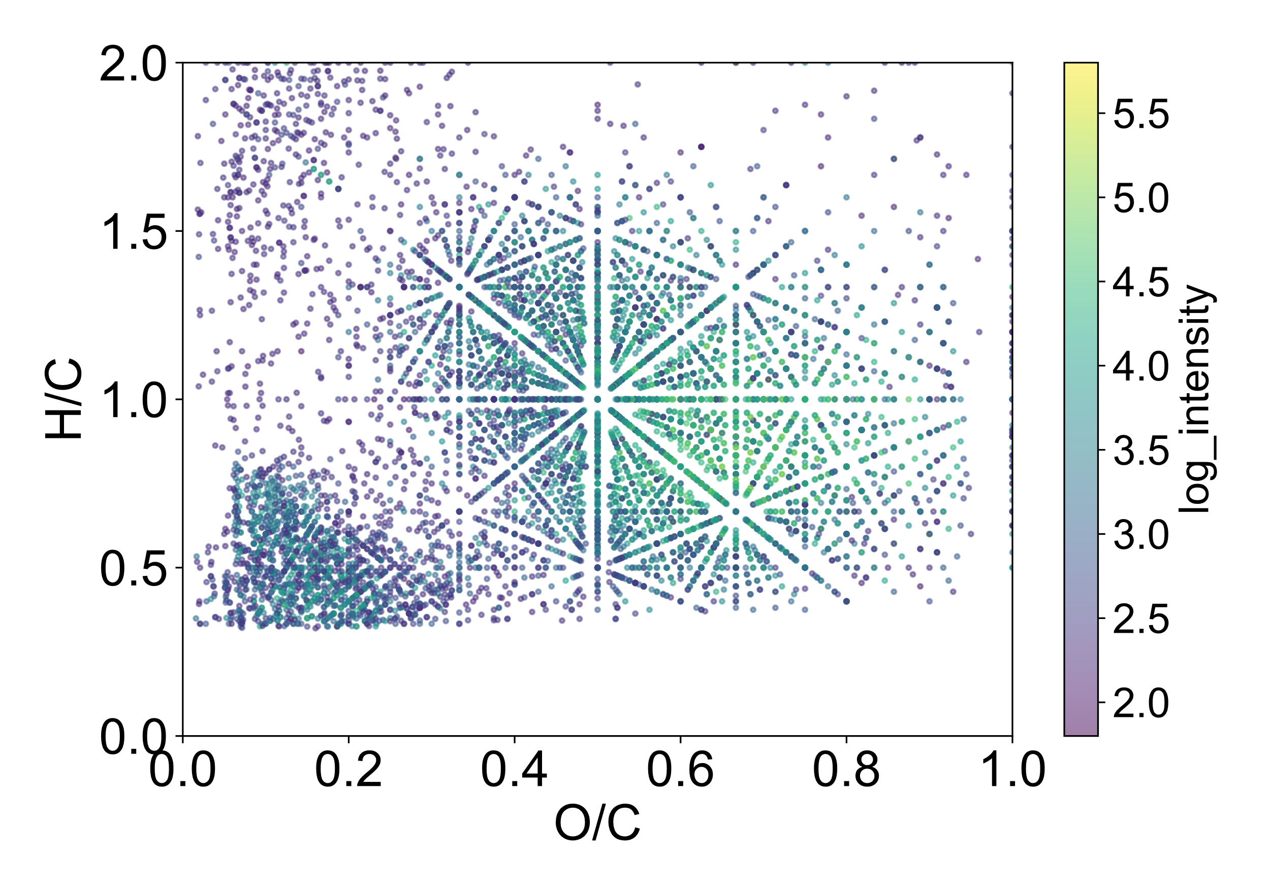
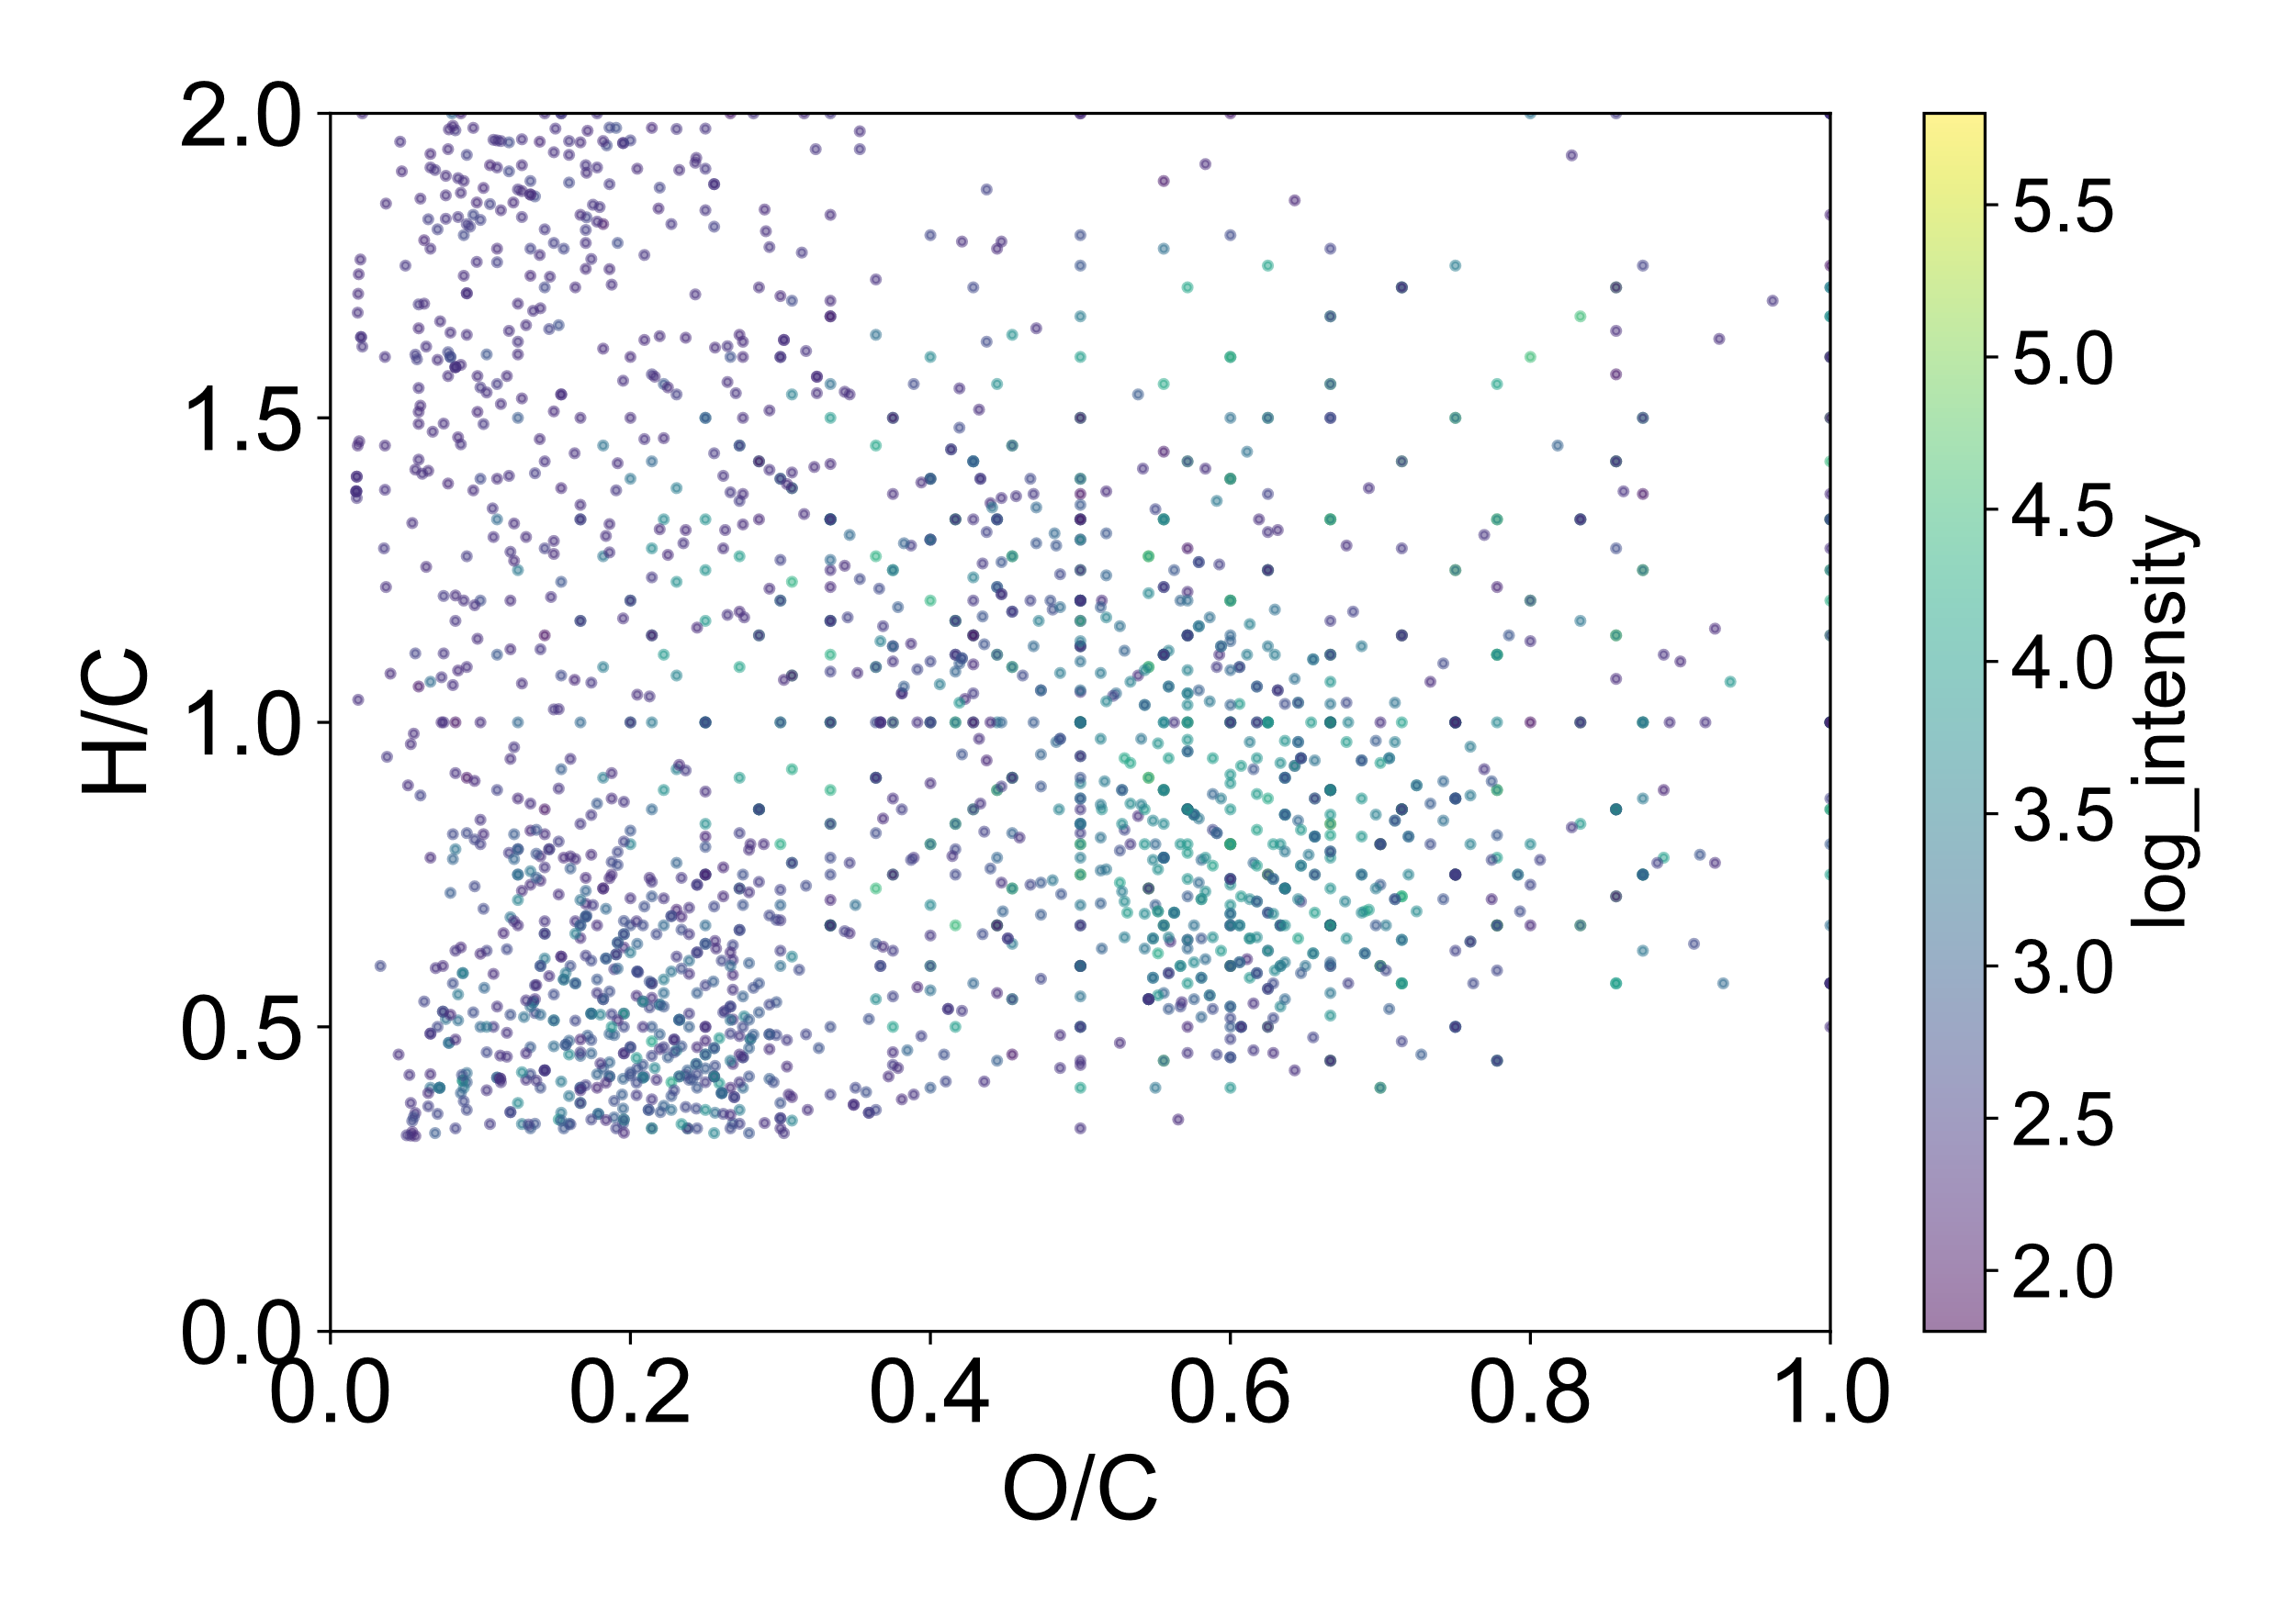
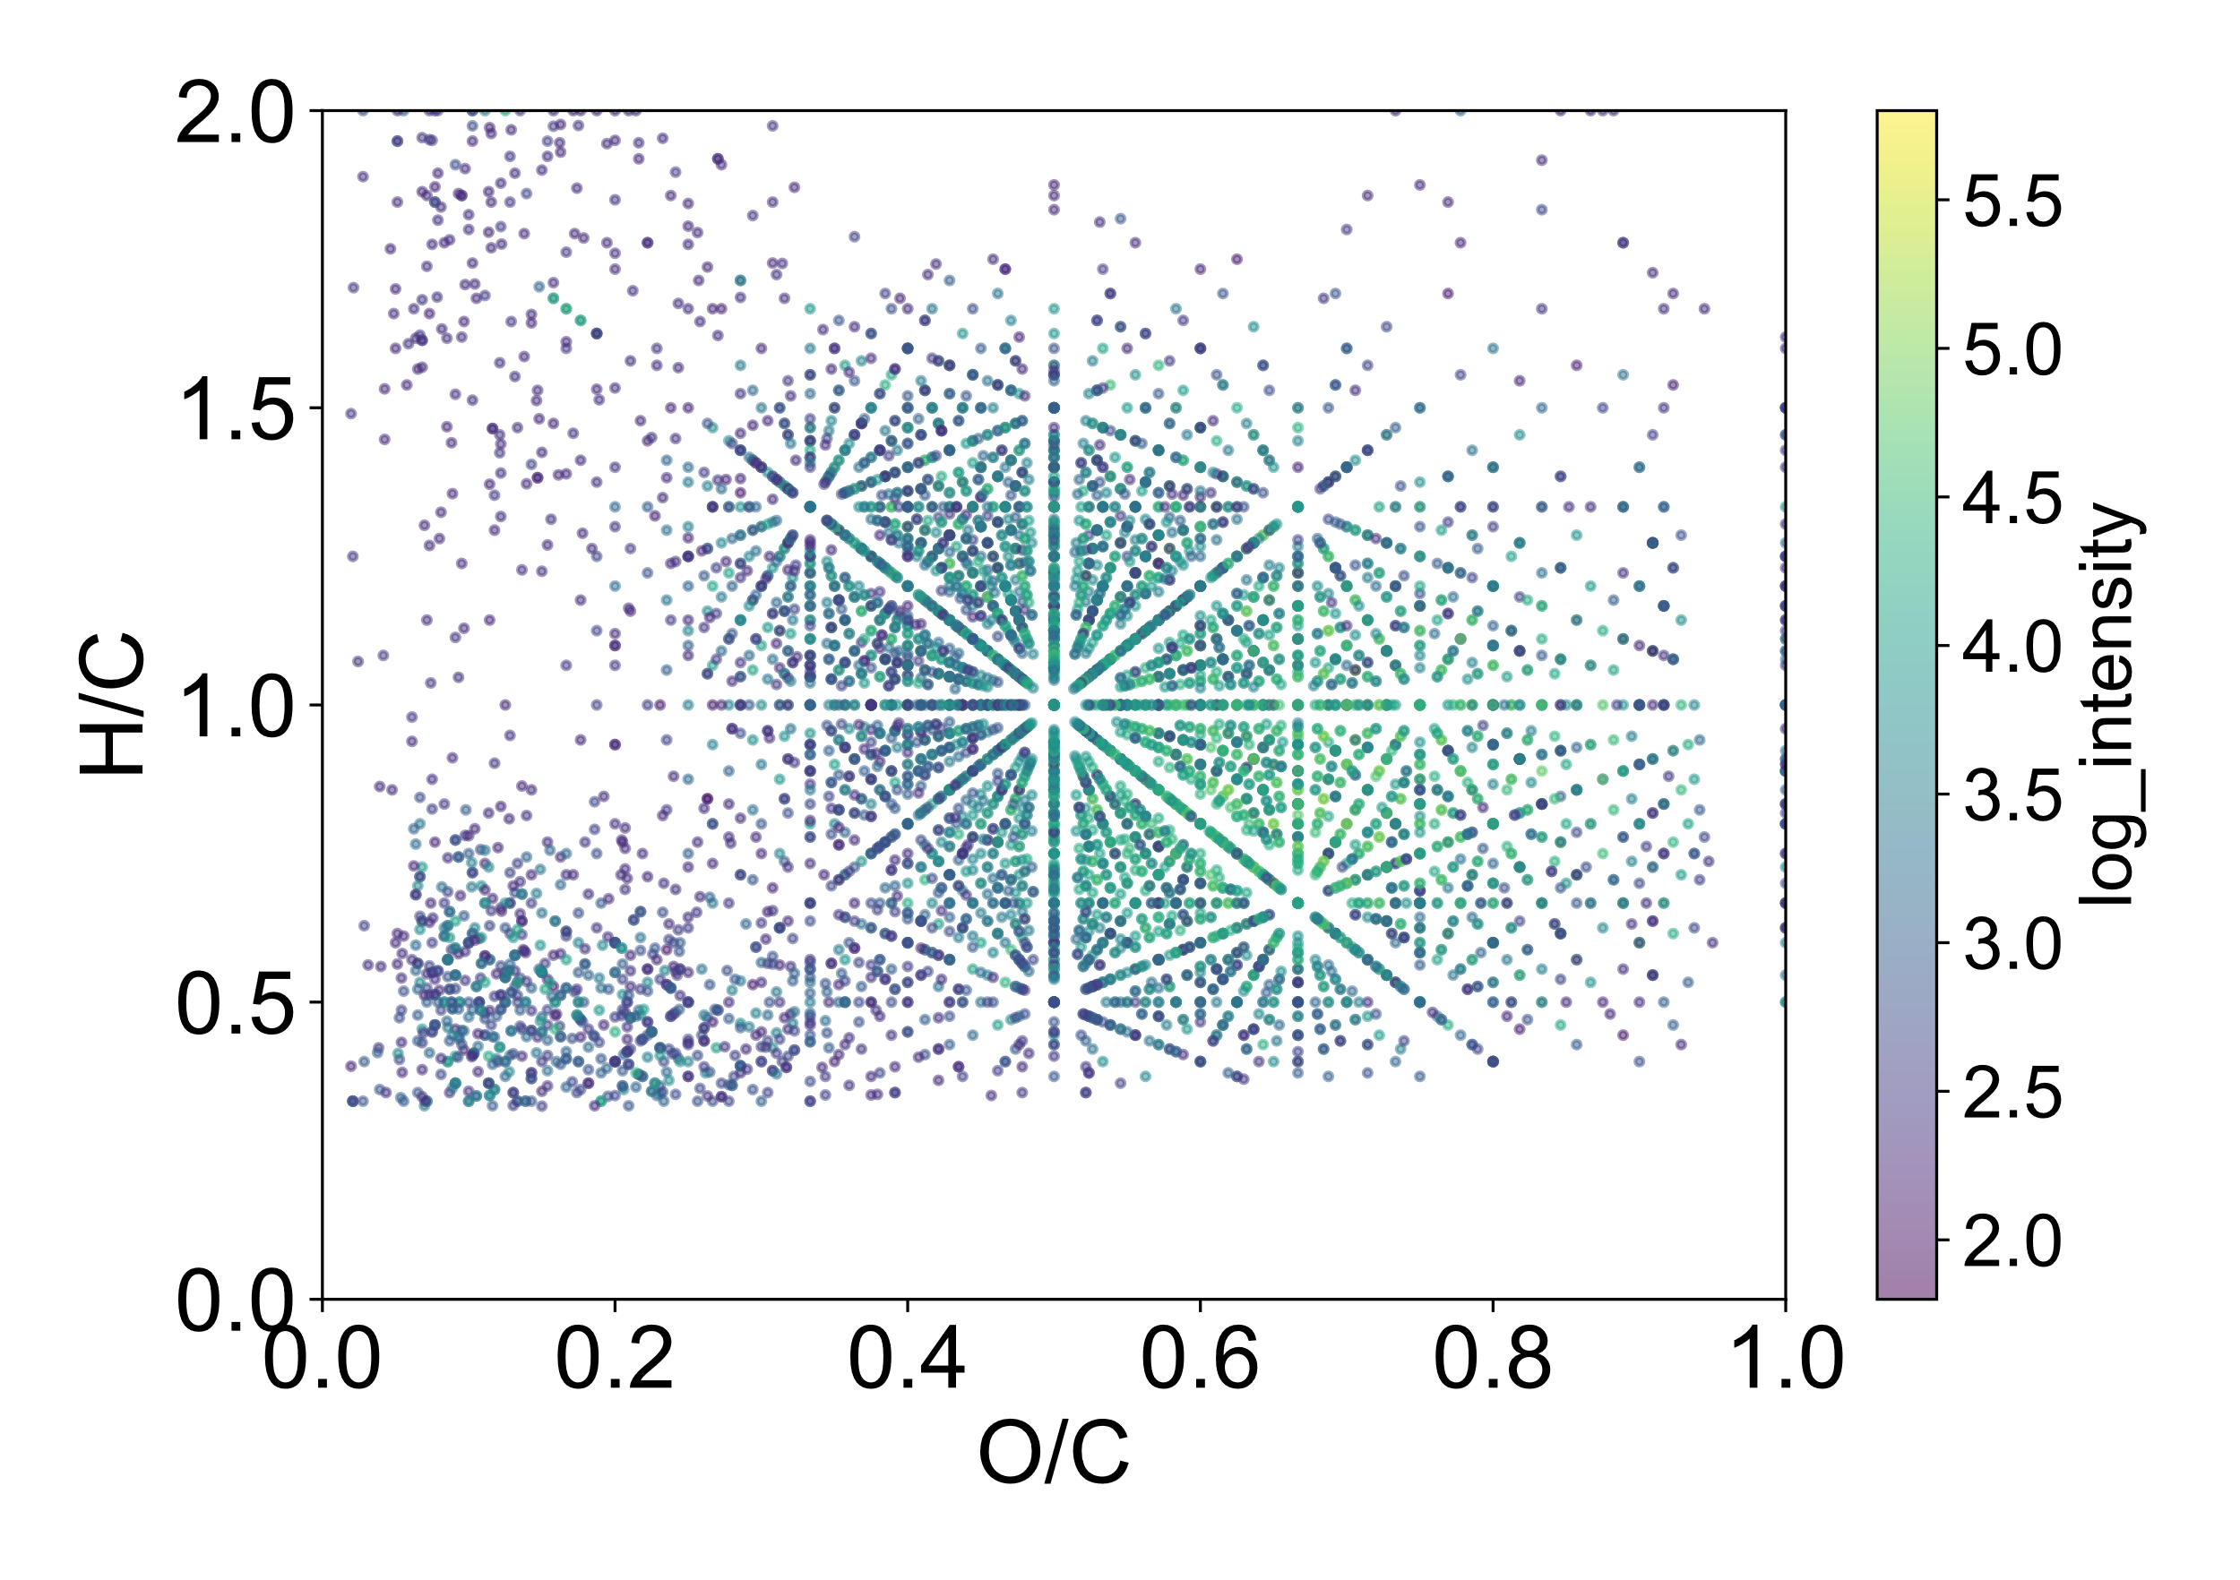
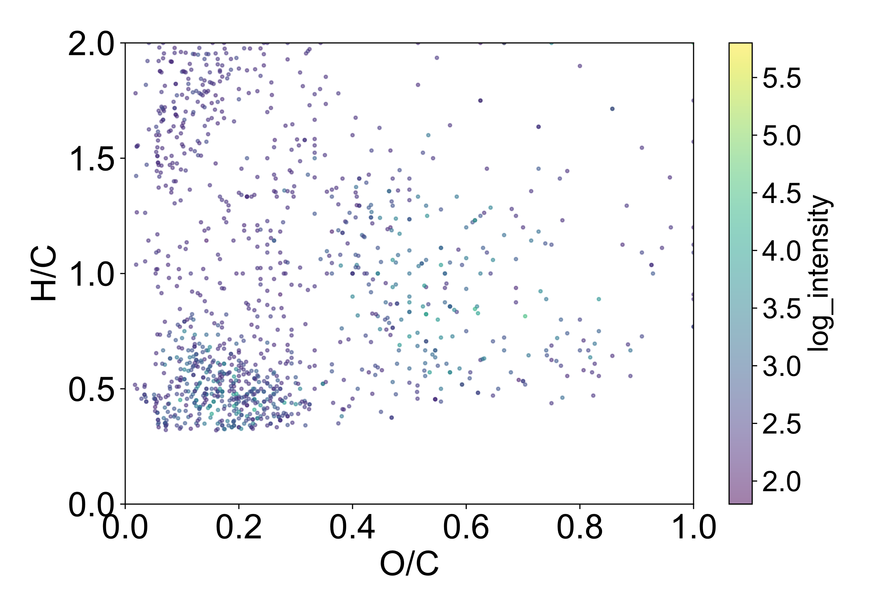
(a)
(b)
(c)
2129
7153
1216
9282 peaks
8369 peaks
9282 peaks
(d)
(e)
(f)
2129 peaks
7153 peaks
1216 peaks

Slide 5
